Slide 1
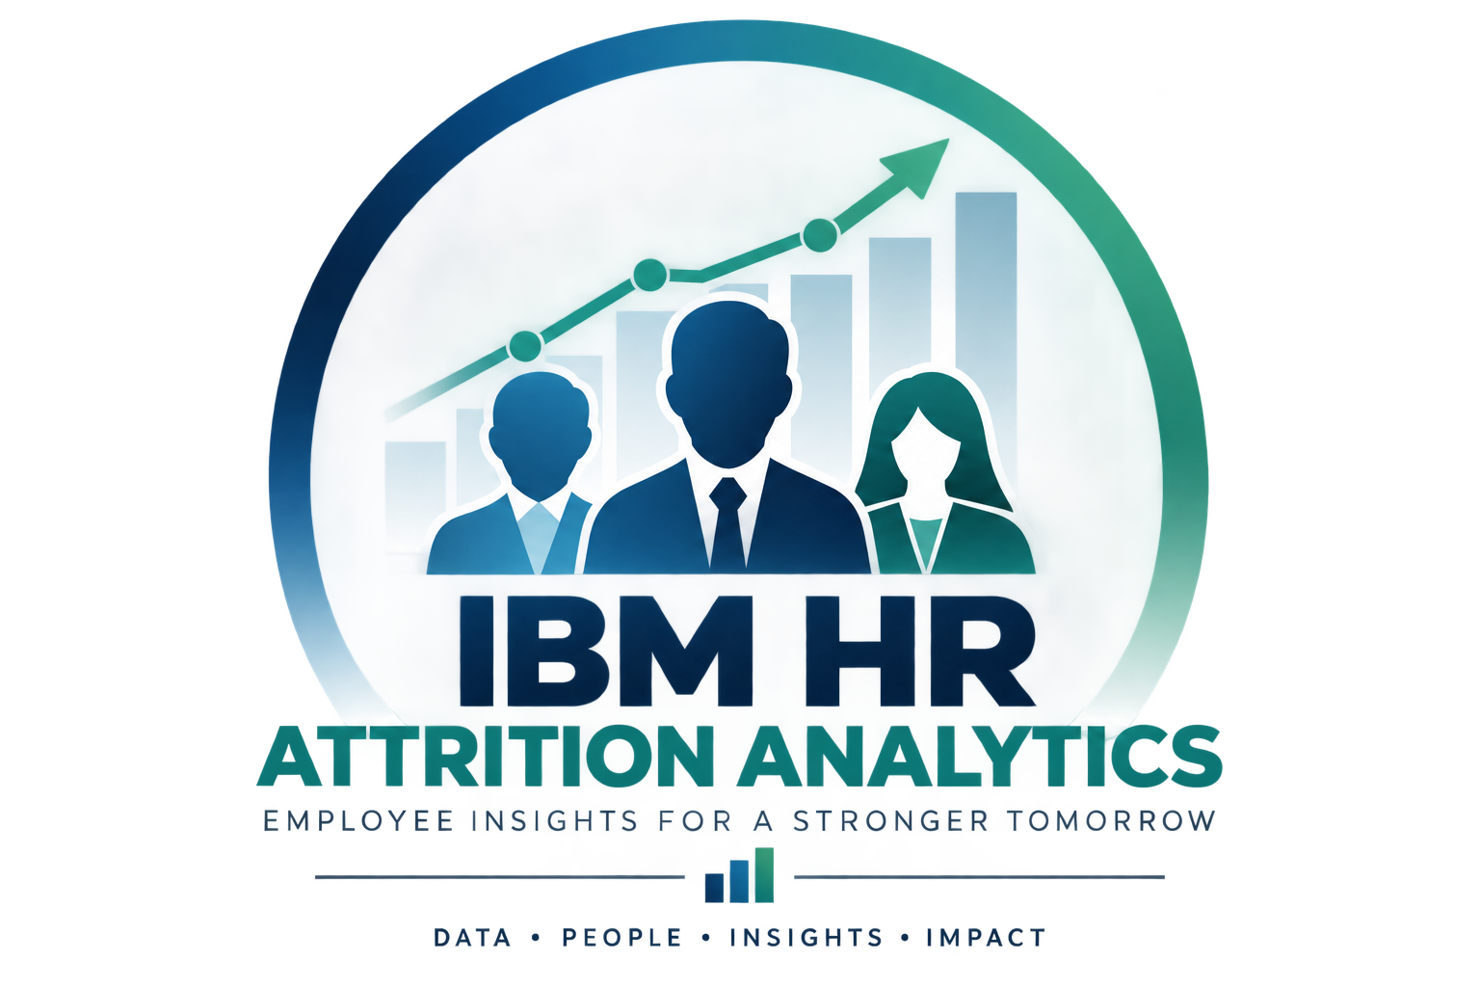
SCTP ASSOCIATE DATA ANALYST CAPSTONE PROJECT
IBM HR Employee Attrition Analytics
From Data to Retention Decisions
Understanding Attrition • Predicting Risk • Supporting HR Retention Strategies
Capstone Project Presentation
Python | Power BI | Streamlit
November 2026
Notes:
Introduce the IBM HR Employee Attrition Analytics capstone and its focus on proactive retention decision support.

Slide 2
PROJECT OBJECTIVES
From Attrition Analysis to HR Action
Five objectives connect understanding attrition to practical HR retention strategies.
Analyse employee attrition patterns across departments, job roles and key employee characteristics to identify groups with higher attrition rates.
Develop and compare machine learning models to predict employee attrition.
Evaluate the selected predictive model, assess probability calibration and identify important predictors of attrition.
Assess predicted employee attrition risk and develop an interactive Power BI dashboard to support workforce-level analysis and employee risk investigation.
Recommend practical HR retention strategies and an implementation plan to help reduce attrition and support proactive workforce planning.
1
2
3
4
5
Analyse
Develop
Evaluate
Assess
Recommend
Attrition Patterns
Predictive Models
Model Performance
Employee Risk
HR Strategies
PROJECT FLOW
Understand → Predict → Validate → Investigate → Act
Notes:
Explain the five project objectives. Streamlit is an additional interactive deliverable, not a separate objective.

Slide 3


DATA PIPELINE
Google Colab / Python
From Raw Data to Actionable Insights
Merge on Employee Number
Five source datasets feed a reproducible analysis and two interactive outputs.
5
1,470
22
Clean & Prepare
Source Datasets
Employee Records
Model Predictors
Source Datasets
 | Employees Employee demographic & profiles | Compensation Salary & reward information
 | Performance Performance related measures | Experience Work history & experience
 | Employment Status Employee attrition outcomes
Analyse & Model
Power BI
Streamlit
Interactive HR dashboards
Live prediction and risk exploration
Notes:
Five data sources are consolidated into 1,470 employee records and 22 predictors. Python supports cleaning, analysis and modelling, followed by Power BI and Streamlit outputs.

Slide 4
DESCRIPTIVE ANALYTICS
1
Analyse
Understanding Attrition
Attrition Patterns
1,470
1,233
237
16.1%
Total Employees
Employees Stayed
Employees Left
Attrition Rate
Attrition Rate by Department
Sales
20.6%
Human Resources
19.0%
Research & Development
13.8%
KEY INSIGHT
Sales recorded the highest attrition at 20.6%, exceeding the overall rate of 16.1% by 4.5 percentage points.
Notes:
The overall attrition rate was 16.1%. Sales recorded the highest departmental attrition rate at 20.6%.

Slide 5
DESCRIPTIVE ANALYTICS
1
Analyse
Understanding Attrition Beyond Departments
Attrition Patterns
Multiple factors provide a more complete view of employee attrition.
Employee Profile
Work Characteristics
Career & Engagement
Age, job role and experience
Overtime, business travel and workload indicators
Promotion history, job satisfaction and career progression
ANALYTICAL APPROACH
Examine multiple employee characteristics to better understand attrition patterns, rather than relying on a single factor.
Notes:
Look beyond department by examining employee profiles, work characteristics and career and engagement indicators.

Slide 6
MODEL DEVELOPMENT & EVALUATION
2
3
Develop
Evaluate
Logistic Regression Delivered Stronger Predictive Performance
Predictive Models
Model Performance
● Logistic Regression ● Random Forest | 5-fold cross-validation
ROC AUC
Logistic Regression
0.831
Random Forest
0.808
Recall
Logistic Regression
75.3%
Random Forest
46.3%
✓
Selected: Calibrated Logistic Regression
0.795
72.3%
34 / 47
Test ROC AUC
Test Recall
Actual Leavers Identified
KEY TAKEAWAY
Higher recall and ROC AUC supported Logistic Regression. Calibration improved probability estimates.
Notes:
Five-fold cross-validation supported Logistic Regression over Random Forest. After calibration, the test ROC AUC was 0.795 and test recall was 72.3%, identifying 34 of 47 actual leavers.

Slide 7
PREDICTOR IMPORTANCE
3
Evaluate
What Matters Most in Predicting Attrition?
Model Performance
Top five predictors from permutation importance analysis.
01
Overtime
Work arrangements
02
Stock Option Level
Employee rewards
03
Years Since Last Promotion
Career progression
Number of Companies Worked
Employment history
05
Total Working Years
Work experience
04
Work arrangements, rewards, career progression and experience are useful areas for further investigation.
HR INTERPRETATION
Calibration improved cross-validated Brier Score from 0.160 to 0.098 (lower is better). Predictor importance does not establish causality.
Notes:
Permutation importance highlights overtime, stock option level, promotion history, companies worked and working years. These are associations, not causal effects. Calibration improved Brier score.

Slide 8
EMPLOYEE RISK ASSESSMENT
4
Assess
134 Employees Identified as High Risk
Employee Risk
Predicted attrition risk among 1,233 employees who stayed.
Low Risk
Medium Risk
High Risk
733
366
134
59.5%
29.7%
10.9%
Workforce-Level View
Employee-Level View
Understand how predicted risk is distributed across employees and departments.
Investigate employee risk profiles to support further HR assessment.
KEY TAKEAWAY
10.9% of employees who stayed were classified as high risk, providing HR a starting point for investigation.
Model-estimated risk using synthetic IBM HR data; not confirmed future resignations.
Notes:
Among 1,233 employees who stayed, 733 were low risk, 366 medium risk and 134 high risk. These are model-estimated categories, not known future resignations.

Slide 9
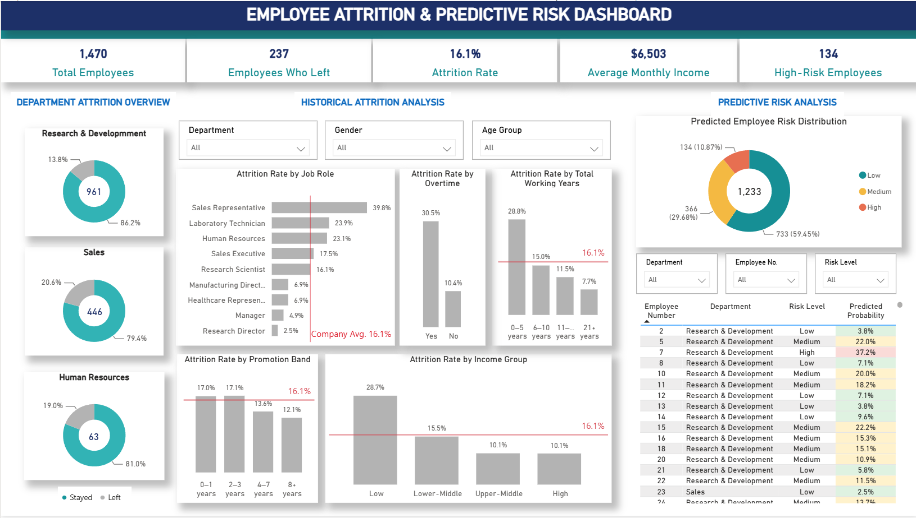
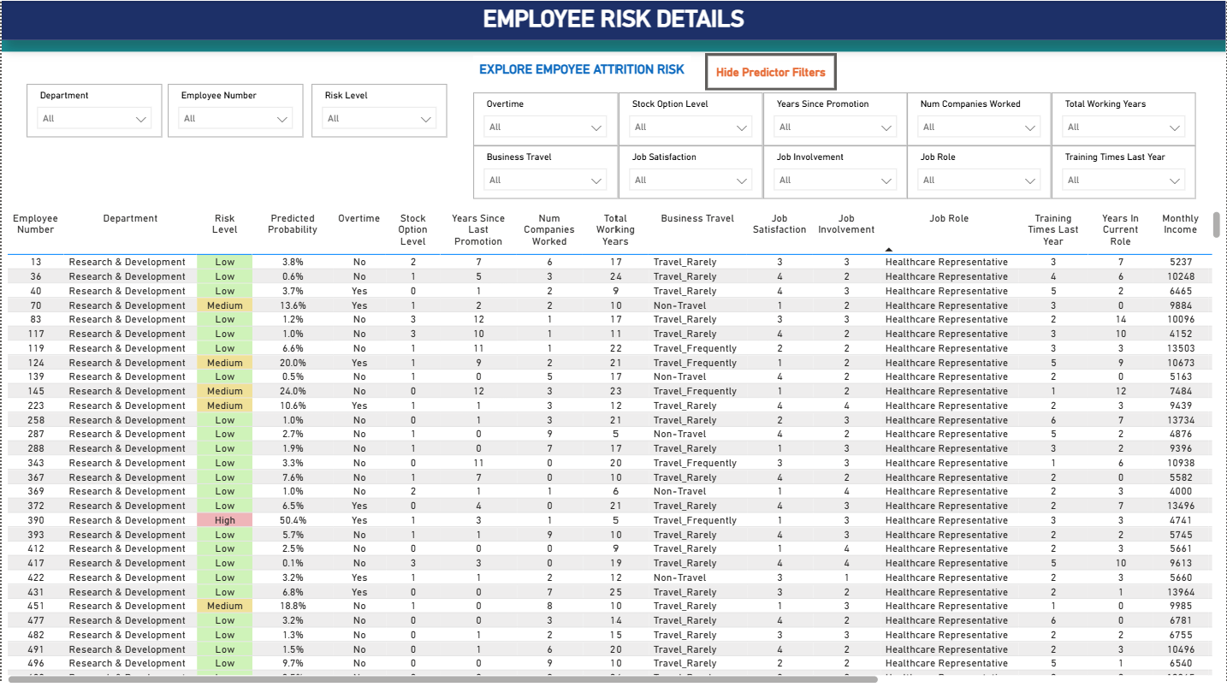
INTERACTIVE ANALYTICS
Power BI Dashboards
Two complementary views: workforce attrition and employee risk details.
Attrition Overview
Notes:
Show the Power BI attrition overview and employee risk detail screenshots when available.

Slide 10
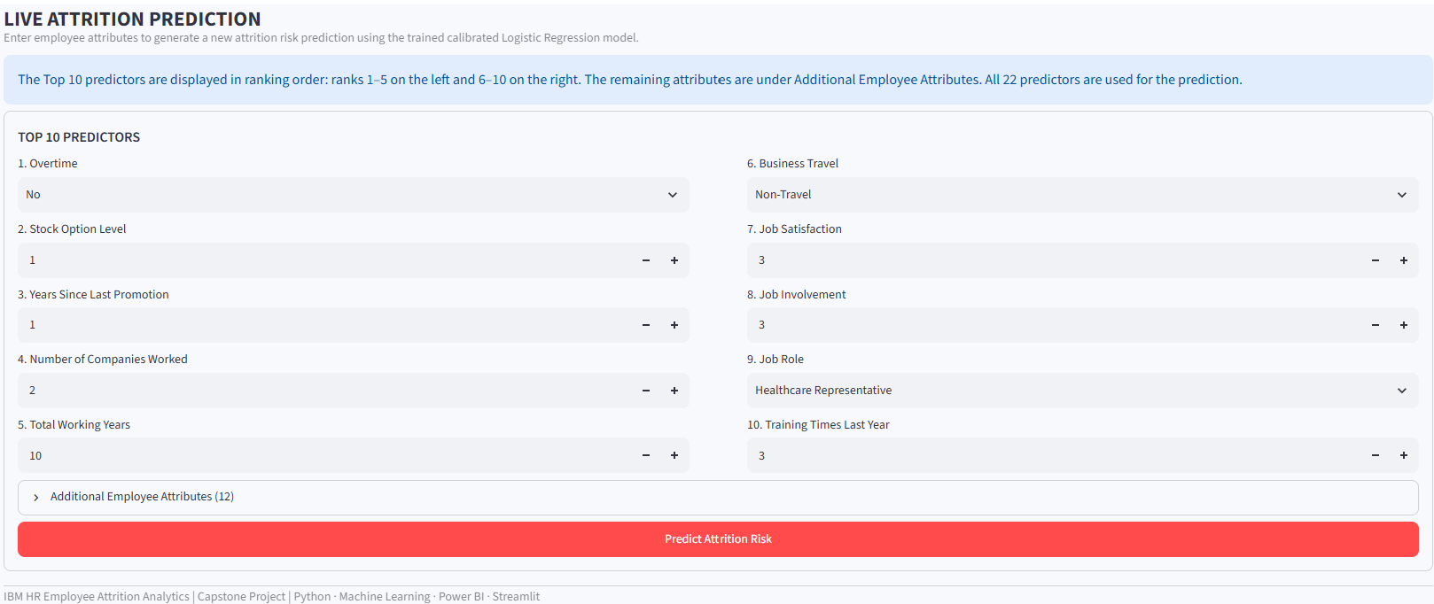
STREAMLIT APPLICATION – LIVE PREDICTION
Predicting Attrition Risk in Real Time
Employee characteristics can be adjusted to generate a new model-estimated attrition probability.
Enter employee characteristics
01
02
Generate predicted risk
03
Support HR investigation
Notes:
Demonstrate live prediction by adjusting employee characteristics and showing the model-estimated probability.

Slide 11
4
5
OBJECTIVE 5 — HR RETENTION STRATEGIES
11 / 13
Assess
Recommend
PROJECT OBJECTIVES
Employee Risk
HR Strategies
From Predictive Insights to Targeted Retention Strategies
Four practical areas for HR to investigate and address.
01
Workload & Well-being
02
Career Development
Review overtime patterns, workload distribution and employee well-being.
Strengthen career conversations, development plans and progression opportunities.
03
Rewards & Recognition
04
Targeted HR Engagement
Review employee rewards, recognition and retention incentives.
Prioritise supportive follow-ups and further assessment of higher-risk groups.
RECOMMENDED APPROACH
Use model findings to guide supportive HR interventions, not employment decisions based solely on risk.
Notes:
Based on the analysis, I identified four areas for HR to consider. First, reviewing workload and overtime patterns. Second, strengthening career development and progression opportunities. Third, examining rewards and recognition. And finally, using predicted risk information to guide more targeted HR engagement. These recommendations are intended to support further investigation and proactive retention planning, rather than treating model predictions as definite outcomes.

Slide 12
4
5
OBJECTIVE 5 — IMPLEMENTATION & CONCLUSION
12 / 13
Assess
Recommend
PROJECT OBJECTIVES
Employee Risk
HR Strategies
From Prediction to Prevention
A phased approach to translate attrition analytics into practical HR decision support.
01
Validate
02
Pilot
Test the model with real HR data and review fairness, calibration and performance.
Introduce risk insights to HR teams and conduct supportive employee engagement.
03
Monitor
04
Refine & Scale
Track attrition trends, interventions and model performance over time.
Improve the approach based on pilot outcomes before wider implementation.
FINAL TAKEAWAY
Turning employee data into earlier, more informed retention decisions.
Proof of concept using synthetic IBM HR data — real-world validation is required before operational use.
Notes:
To bring this project into practice, I recommend a phased approach. First, validate the model using real HR data. Next, pilot the risk assessment with HR teams to support targeted employee engagement. We would then monitor retention outcomes and model performance, and refine the approach before scaling up. To conclude, this project demonstrates how descriptive analytics, machine learning and interactive dashboards can work together to support more proactive workforce planning. The key is not simply predicting who might leave, but helping HR make earlier and better-informed retention decisions.

Slide 13
IBM HR EMPLOYEE ATTRITION ANALYTICS
13 / 13
✦
Thank You
From Data to Retention Decisions
Questions & Discussion
Notes:
Thank the audience and invite questions.

